Slide 1

Iowa-Illinois Safety Council
Safety Awards
Submissions for 2018 accepted
August 1, 2018 through February 8, 2019

Slide 2
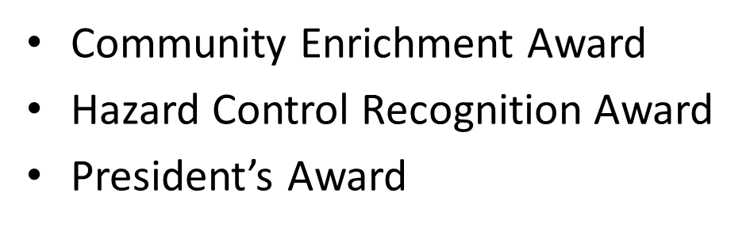

IISC Safety Awards Program

Slide 3
Community Enrichment Award
Recognizes 1 member organization that has contributed significantly to their local community in areas of safety, health or environmental efforts.
  financial contributions, in the areas of safety, health or environmental efforts
  manpower, in the areas of safety, health or environmental efforts
  material resources, in the areas of safety, health or environmental efforts
  or other services, in the areas of safety, health or environmental areas
To apply for the Community Enrichment Award submit a presentation or report (word, pdf, etc.) on how your company has made a difference in your local community, based on above criteria.

Slide 4
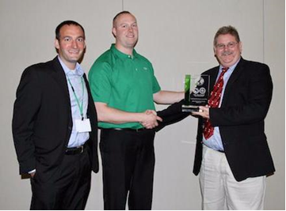
Community Enrichment Award
2017 Community Enrichment Award winners Sukup Manufacturing Company Sheffield, IA.

Slide 5
Community Enrichment Award submissions
Send your supporting materials to:
Community Enrichment Award
Attention: Dan Culbertson
Iowa-Illinois Safety Council
  1501 42nd Street Suite 100 West Des Moines, IA 50266
  Or email your information to: dan@iisc.org
• BE SURE TO INCLUDE:
Organization name, contact, & contact information
  BEFORE the end of the day, February 8, 2019

Slide 6
Hazard Control Recognition Award
The Hazard Control Recognition Award is based on implemented hazard controls within IISC Member Organizations.
A Hazard Control is a specific, identifiable change implemented to reduce or eliminate an individual’s exposure to a hazard in the workplace.
  Engineering control, redesign, guarding
  Work practice changes that eliminate or reduce the risk to a hazard
  Improvements to the personal protective equipment used by workers
  Changes for previously uncontrolled environmental risk
  Training on its own will not qualify as a hazard control. Training in conjunction with controlling a hazard can qualify, as long as there is documentation of the hazard prior to the training, along with the controls put in place to eliminate the hazard.

Slide 7
President’s Award
The Presidents Award is awarded to five organizations that have submitted for the Hazard Control Recognition Award. Recipients of this award, chosen by the IISC Board of Directors President, President-Elect, and Past President, will be selected for their outstanding contribution in Hazard Control

Slide 8
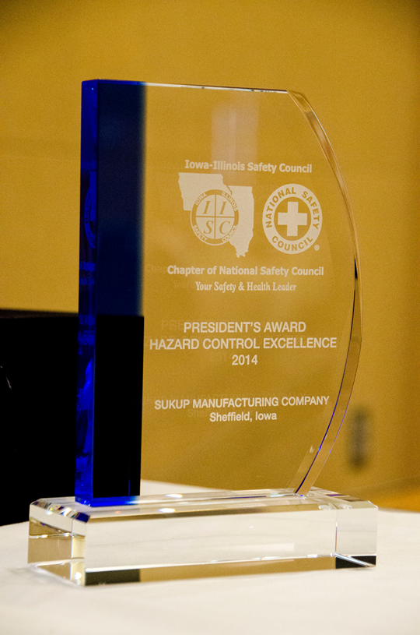
President’s Award
2016 Award Winners
  John Deere Ottumwa Works--Ottumwa, IA
  Essentia Protein Solutions--Harlan, IA
  Colony Brands Peosta Warehouse--Peosta, IA
  Syngenta Seeds LLC--Jefferson, IA
  Monsanto Clarion Soybean Production--Clarion, IA

Slide 9
Hazard control Awards submission
Each member organization may submit between one and five hazard control projects.
  Organizations meeting the minimum requirement will earn a hazard control award.
Each hazard control is to be submitted on a Plain White Single PowerPoint Slide (Intructions and examples starting on slide 11)
Applications to be submitted to dan@iisc.org between August 1, 2018 through February 8, 2019
Late submissions will not be accepted for the 2018 Awards

Slide 10
IISC Award Slide Guidelines
One Plain White PowerPoint slide per hazard control
Any layout you choose. You may:
  Include pictures (before & after) if applicable
  BRIEF descriptions of the hazard and benefit from control
  SHOW HOW UNIQUE YOUR PROJECT IS!
  Include organization contact information in notes section (see next slide for template information)
  Send to dan@iisc.org before the end of the day, February 8, 2019.

Slide 11
IISC Award Slide Guidelines
  Include organization contact information in “NOTES” section of your PowerPoint.
  Organization Name as it WILL appear on your company plaque & in the Professional Development Conference & Expo program:
  Contact person for this application:
  Contact phone:
  Contact e-mail:
  Mailing and Shipping address or addresses:

Slide 12
Presidents Awards Submission
Five (5) organizations judged to have outstanding controls will earn the “President’s Award”, in addition to the Hazard Control Recognition Award.
  All accepted Hazard Control Award Submissions will be considered for the Presidents Award
  Award winners will be notified by April 2019

Slide 13
Explanation of Project
Before
After
Before picture can be inserted here
After picture can be inserted here
Notes:
Organization Name as it should appear on plaque & in program:
Contact for this application:
Contact phone:
Contact e-mail:
Mailing address:

Slide 14
Brief explanation of hazard
After Photo of the project may be inserted here.
Photo of hazard may be inserted here
Brief explanation of how the hazard was controlled.
Notes:
Organization Name as it should appear on plaque & in program:
Contact for this application:
Contact phone:
Contact e-mail:
Mailing address:

Slide 15
On the rare occasions we need to access the roof at Robert’s Soap & Safety, we wanted to ensure the ladder would not be blown down by the wind.
Notes:
Organization Name: Robert’s Soap & Safety
Contact: Robert Vaughan, CEO
Contact phone: 123-555-5555
Contact e-mail: robssoap@gggmail.commm
Mailing address: 1234 Main Street, somewhere, IA 55555

Slide 16
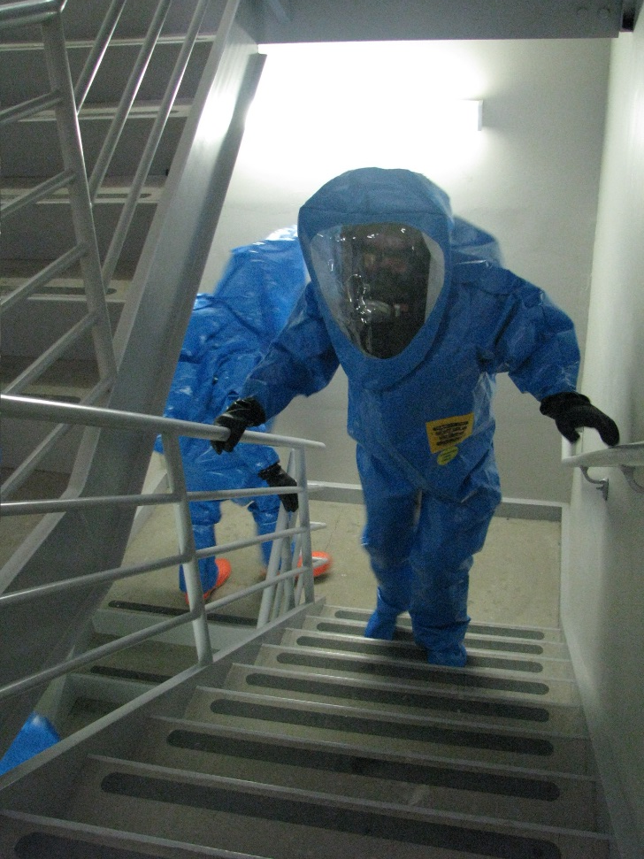
Hazardous Material Spill Response Teams
After:
Recently, we were able to train enough employees to have full HazMat response on all three shifts, and several back-ups.
We are now equipped to handle a spill within the facility during all shifts.
Before:
For the past several years, Robert’s Soap & Safety had one full Hazardous Material Spill Response Team, but they were all on first shift. We have been expanding our Second and Third shift operations.
Notes:
Organization Name: Robert’s Soap & Safety
Contact: Robert Vaughan, CEO
Contact phone: 123-555-5555
Contact e-mail: robssoap@gggmail.commm
Mailing address: 1234 Main Street, somewhere, IA 55555

Slide 17
Thank you
Contact Dan Culbertson with questions
515-276-4724 ext. 228 or dan@iisc.org

